Slide 1
EU-TEMPUS Project “EINSEE” – Development and implementation of sustainable structures for entrepreneurship education in Russia and Tajikistan
Gerhard Geissler
Vienna University of Economics and Business
Berlin, August 2013

Slide 2
Structure of the presentation
The society of transition countries: A short insight
Change through Entrepreneurship Education: TEMPUS project EINSEE – RU-TJ
Theoretical aspects: Niklas Luhmann and John W. Meyer – Systems Theory and New-Institutionalism at a glance
Confines and possibilities of change in the education system from the viewpoint of Systems Theory and New-Institutionalism
Practical aspects: Inducing sustainable change
Discussion of findings

Slide 3
The society of transition countries: A short insight

Slide 4
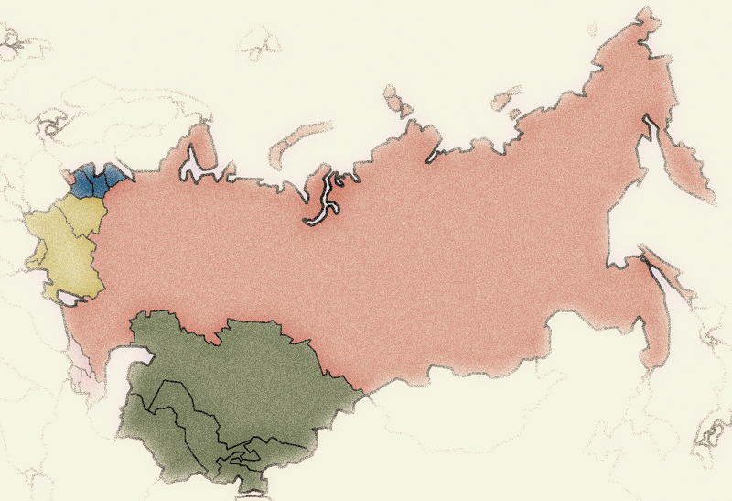
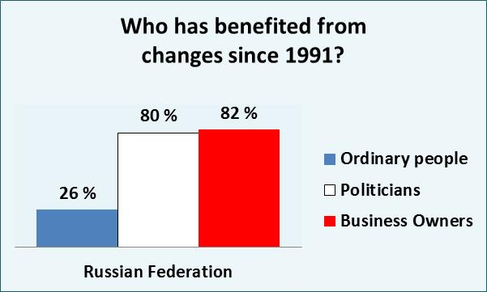
Some scattered statements related to the topic
Education has become an important part of the „World Society“ under the label of „World Polity“
Education is the most powerful weapon which you can use to change the world.
(Nelson Mandela)

Slide 5
Change through Entrepreneurship Education: TEMPUS project EINSEE – RU-TJ

Slide 6
Civil society
Future
Eco-social market economy
Aim 1 – Creation of a subject
Aim 2 – Further training and development for existing teachers
EU-Tempus-Projekt:
Entwicklung und Implementierung nachhaltig wirksamer Strukturen zur Entrepreneurship Erziehung in Russland und Tadschikistan
Entwicklung von Kursmodulen zur
Qualifizierung fachfremder
Lehrer/innen
Sicherung der pädagogischen
Professionalität und der
didaktisch-methodischen
Kompetenz
Aim 3 – Teacher training
Ziel 2
Ziel 3
mit ausgewiesenen Zeitdeputaten
auf der Basis eines kompetenz-
orientierten Lehrplans und
Bildungsstandards
Implementierung bzw. Modernisierung wirtschafts- und gesellschaftskunde-didaktischer Ausbildungsangebote in der Bologna-Architektur
TEMPUS-Project
EINSEE – RU-TJ
2010 - 2013
Ensuring long-term sustainability
Ziel 1
Ensuring medium-term sustainability
Central measure to establish structure
Dynamic stability

Slide 7
Civil society
Future
Eco-social market economy
Dynamic stability

Slide 8
Civil society
Future
Eco-social market economy
EU-Tempus-Project - EINSEE:
Entwicklung und Implementierung nachhaltig wirksamer Strukturen zur Entrepreneurship Erziehung in Russland und Tadschikistan
Development and implementation of sustainable structures for entrepreneurship education in Russia and Tajikistan
Dynamic stability

Slide 9
Civil society
Future
Eco-social market economy
EU-Tempus-Projekt:
Entwicklung und Implementierung nachhaltig wirksamer Strukturen zur Entrepreneurship Erziehung in Russland und Tadschikistan
Aim 2
Aim 3
Aim 1
Dynamic stability

Slide 10
Civil society
Future
Eco-social market economy
Aim 1 – Creation of a subject
EU-Tempus-Projekt:
Entwicklung und Implementierung nachhaltig wirksamer Strukturen zur Entrepreneurship Erziehung in Russland und Tadschikistan
Ziel 2
Ziel 3
with explicit time quota
on the basis of a competence
oriented curriculum and
educational standards
Ziel 1
Central measure to establish structure
Dynamic stability

Slide 11
Civil society
Future
Eco-social market economy
Aim 1 – Creation of a subject
Aim 2 – Further training and development for existing teachers
EU-Tempus-Projekt:
Entwicklung und Implementierung nachhaltig wirksamer Strukturen zur Entrepreneurship Erziehung in Russland und Tadschikistan
Development of course modules to
qualify non-specialist teachers
support pedagogical
professionality and didactical-
methodical competence
Ziel 2
Ziel 3
mit ausgewiesenen Zeitdeputaten
auf der Basis eines kompetenz-
orientierten Lehrplans und
Bildungsstandards
Ziel 1
Ensuring medium-term-sustainability
Central measure to establish structure
Dynamic stability

Slide 12
Civil society
Future
Eco-social market economy
Aim 1 – Creation of a subject
Aim 2 – Further training and development for existing teachers
EU-Tempus-Projekt:
Entwicklung und Implementierung nachhaltig wirksamer Strukturen zur Entrepreneurship Erziehung in Russland und Tadschikistan
Entwicklung von Kursmodulen zur
Qualifizierung fachfremder
Lehrer/innen
Sicherung der pädagogischen
Professionalität und der
didaktisch-methodischen
Kompetenz
Aim 3 – Teacher training
Ziel 2
Ziel 3
mit ausgewiesenen Zeitdeputaten
auf der Basis eines kompetenz-
orientierten Lehrplans und
Bildungsstandards
Implementation resp. modernization of business education opportunities on the basis of the Bologna Accords
Ensuring long-term sustainability
Ziel 1
Ensuring medium-term-sustainability
Central measure to establish structure
Dynamic stability

Slide 13
Civil society
Future
Eco-social market economy
Aim 1 – Creation of a subject
Aim 2 – Further training and development for existing teachers
EU-Tempus-Projekt:
Entwicklung und Implementierung nachhaltig wirksamer Strukturen zur Entrepreneurship Erziehung in Russland und Tadschikistan
Entwicklung von Kursmodulen zur
Qualifizierung fachfremder
Lehrer/innen
Sicherung der pädagogischen
Professionalität und der
didaktisch-methodischen
Kompetenz
Aim 3 – Teacher training
Ziel 2
Ziel 3
mit ausgewiesenen Zeitdeputaten
auf der Basis eines kompetenz-
orientierten Lehrplans und
Bildungsstandards
Implementierung bzw. Modernisierung wirtschafts- und gesellschaftskunde-didaktischer Ausbildungsangebote in der Bologna-Architektur
TEMPUS-Project
EINSEE – RU-TJ
2010 - 2013
Ensuring long-term sustainability
Ziel 1
Ensuring medium-term sustainability
Central measure to establish structure
Dynamic stability

Slide 14
Entrepreneurship education between entrepreneurial/professional autonomy and promotion of civil society
Level IV: Entrepreneurship – promoting an “entrepreneurial spirit”
Level III: Entrepreneurship – promoting civil society (social entrepreneurs)
Level II: Entrepreneurship – economics education
(context and conditions of market economy)
Level I: Entrepreneurship – business education
Entrepreneurial
autonomy
Professional
autonomy
Founding companies
Setting up businesses
Employees as
co-entrepreneurs
… Understanding market economy – introduction to micro and macroeconomics & economic policy
... through development of pedagogic objectives such as maturity, responsibility & a well-informed outlook
i.e. attitudes such as independence, assumption of responsibility etc.

Slide 15
“Principles of construction” for the curriculum for the subject economics at secondary schools in RU and TJ on the basis of the four-level model of entrepreneurship education
Promotion of entrepreneurial virtues ranging from the spirit of innovation and motivation to the assumption of responsibility for oneself and society
Social business as entrepreneurship’s contribution to a dynamic
civil society and thus to the promotion of counter-hegemonic projects
Entrepreneurship
Entrepreneurship as a curricular/didactic orientation
to determine content of curriculum and skills
Business plan as subject-specific
didactic approach
to link up business knowledge
and skills
Level I
Understanding the
market economy –
including complex
economic issues
Level II
Level III – “Entrepreneurship as basic qualification of the citizen”
(cf. Faltin/Zimmer 1998, p. 261)
Level IV – Transmission of attitudes and skills for a dynamic economy and society

Slide 16
Theoretical Aspects I: Niklas Luhmann‘s Systems Theory

Slide 17
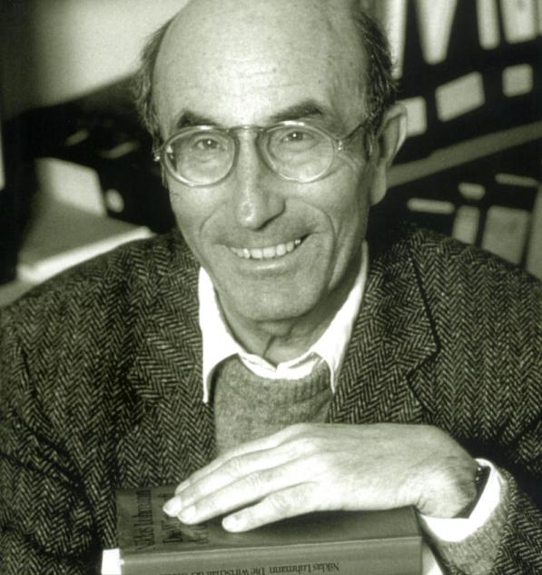
Niklas Luhmann‘s Systems Theory at a glance
Systems
Social systems
Inter-actions
Organi-sations
Psychic systems
Societies
Systems are autopoietic systems.
Autopoietic systems are operatively closed.
External events may trigger internal processes of autopoietic systems but they cannot determine those processes.
Psychic systems reproduce themselves on the basis of thoughts.
Social systems reproduce themselves on the basis of communication.
The production of communications is influenced through expectations
The production of new elements depends on the existing elements.

Slide 18
Organizations, psychic systems and their interpenetration
Organizations
organizations re-produce themselves on the basis of decisions.
Decisions are a specific form of communication.
Decisions are influenced by decision premises.
There are three types of decision premises:
  Programmes define conditions for correct decision making.
  Personell concerns the recruitment of personell.
  Communication channels regulate the communication in the organization.
Relation between organizations and psychic systems
Without psychic systems social systems are impossible – and probably vice versa.
There merely exists a relation of structural coupling: both types of systems are structurally adapted to each other in a way which allows for mutual irritation.
Because of their structural coupling social systems can expect their communications to cause irritations in the psychic systems and to receive irritations from the psychic systems when necessary.
Psychic processes are synchronised with communication processes and, in this way, they “know” when to contribute irritations to the communication process in order to make the reproduction of the social system possible.
Psychic systems
Psychic systems are constituted on the basis of a self-referential relations of consciousness.

Slide 19
Theoretical Aspects II: John W. Meyer‘s New-Institutionalism

Slide 20
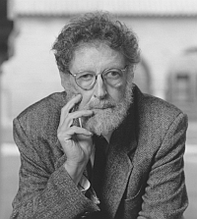
John W. Meyer‘s New-Institutionalism at a glance
In numerous empirical studies new-institutionalist researchers found substantial isomorphism across countries in several social realms, e. g. education.
The nation state, organizations and the individual are three main actors in the society.
All three actors are constituted in continuous rationalization processes and in doing so they follow a “script” sprung from Western civilization.
Formal organizations are viewed as legitimate only as long as they follow certain rules in their proceedings.
There are different influences of institutional isomorphism:
  Coercive isomorphism stems from political influence.
  Mimetic isomorphism is copying successful behaviors.
  Normative isomorphism is associated with professional values.

Slide 21
Confines and possibilities of change in the education system from the viewpoint of Systems Theory and New-Institutionalism

Slide 22
The education system: A network of manifold coupled organizations and players
How is change possible?
Officers
Principals
Adminis-tration
(Organization)
School
(Organization)
Science
(Society)
Voters
Teachers
Professors
Political Sysem
(Society)
Teaching
(Interaction System)
Students
Universities
(Organizations)
Teachers
Parents
Employees
Consumer
Political parties
(Organizations)
Politicians
Enterprises
(Organization)
Economy
(Society)

Slide 23
How is change possible?
Systems Theory
New-Institutionalism
Organization and environment
Psychic Systems can irritate social systems.
If the irritation is permanent some change in the social system may happen because the social system has to care for progress in knowledge.
To meet the expectations of the environment it is possible that the surface (“Schauseite”) of an organization and the formal structures of an organization may change but not the operations of an organization.
Organizations have to meet the expectations in order to be legitimated.
New-institutionalism distinguishes between formal structures and activities of an organization.
These two levels are loosely coupled.
Because of these loosely coupled levels, isomorphism concerns regularly the formal structure of organizations but not necessarily their activity structure.
Players
Only people with professional competence, motivation, enthusiasm and critical thinking who like to act as innovative pioneers are able to induce change in the organization.

Slide 24
Practical Aspects: Inducing sustainable Change

Slide 25
How to make an education development project sustainable
Key factors for the project management of an international education development project
Organization and environment
  Attention
  Importance
  Communication
  Efficiency
Mechanisms of change
  Players – Entrepreneurs of education

Slide 26
Discussion of findings

Slide 27
To bring forward change and avoid “business as ususal”
How can we use these findings for school development?
How can we use these findings for teacher training?
…?

Slide 28
Prof. Mag. Dr. Gerhard Geissler, MSc
Institut für Wirtschaftspädagogik
Wirtschaftsuniversität Wien
Welthandelsplatz 1
1020 Wien
gerhard.geissler@wu.ac.at

